Slide 1
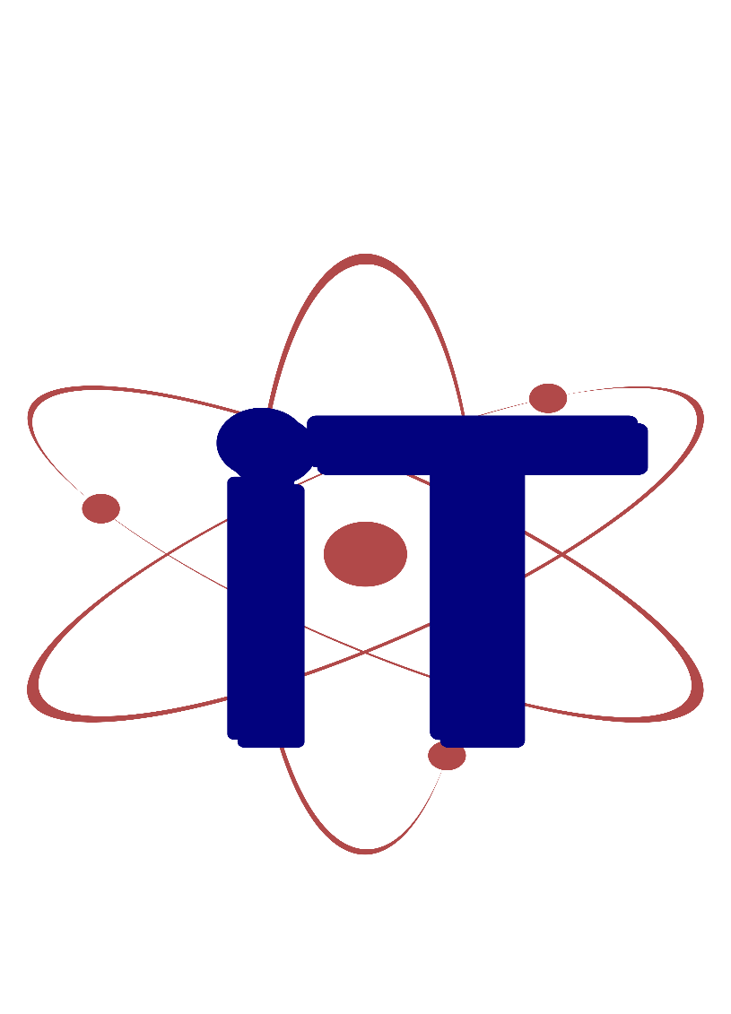

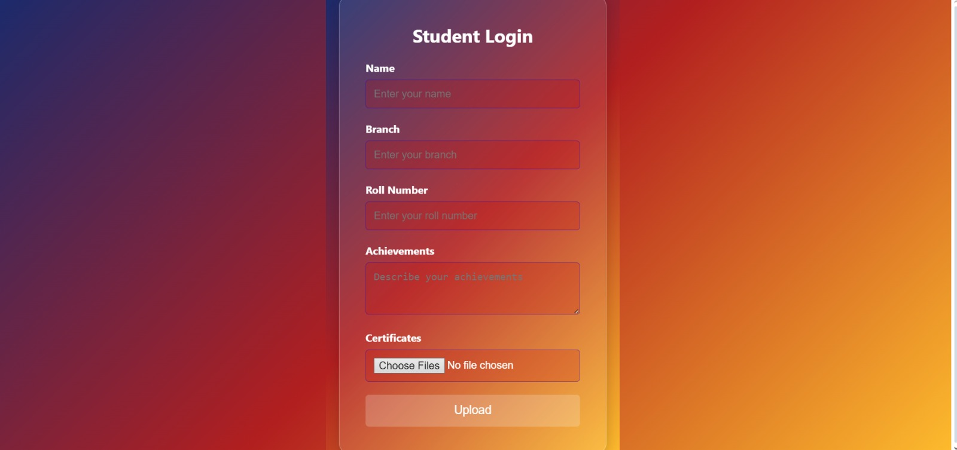
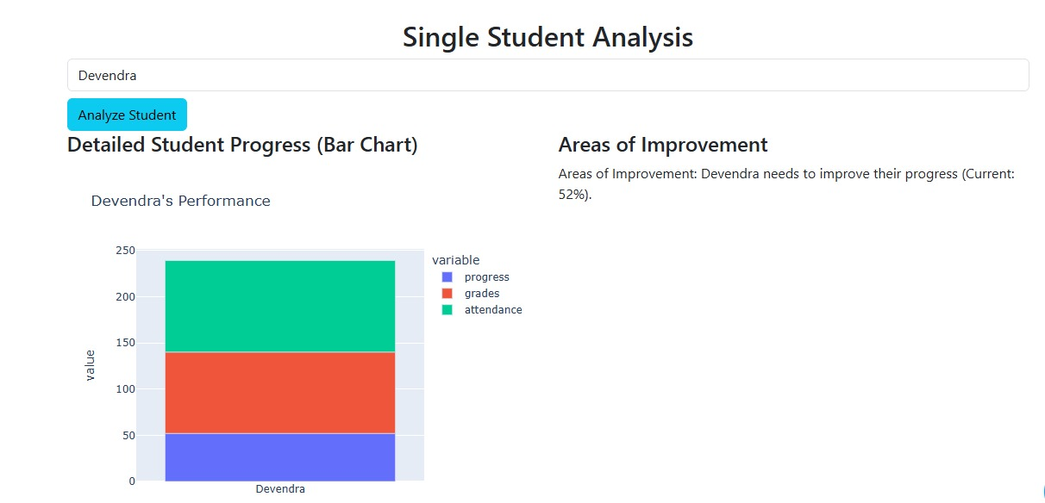
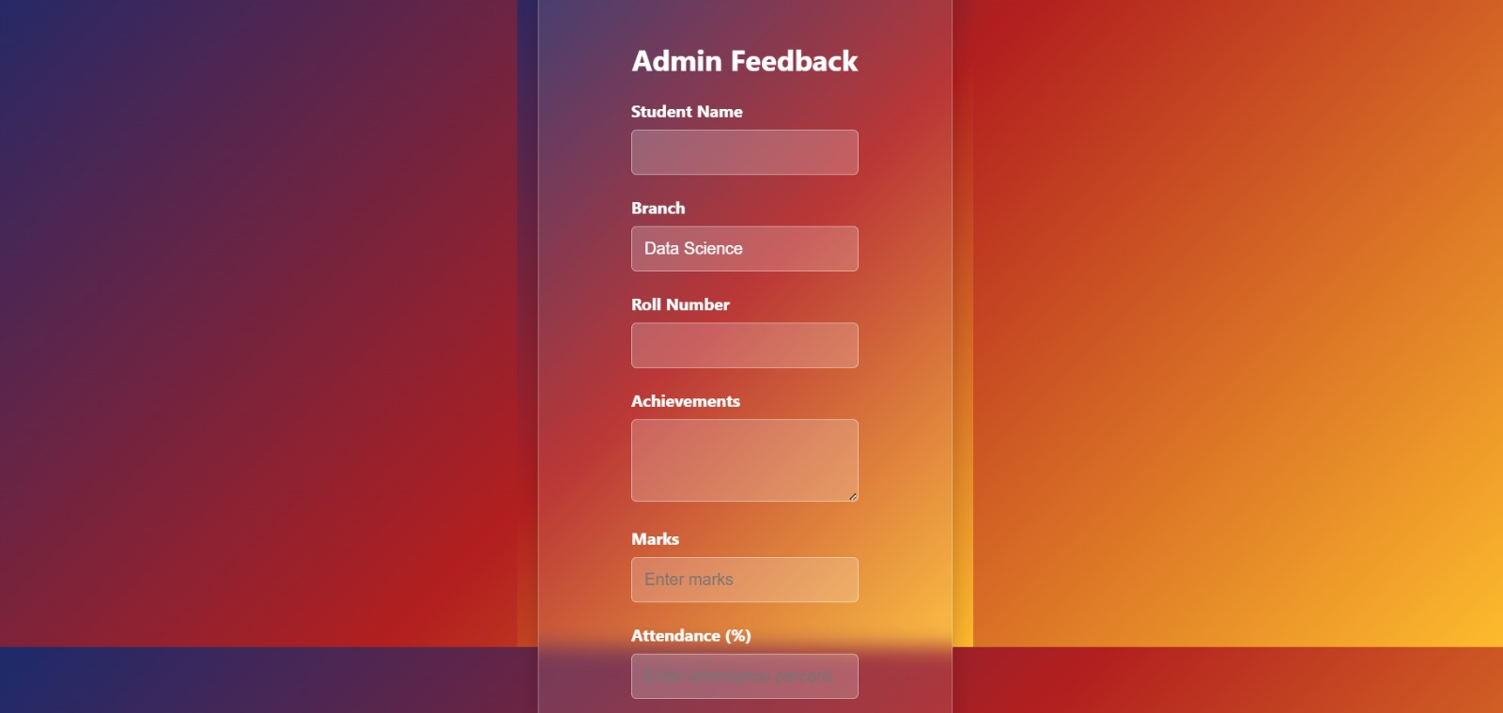
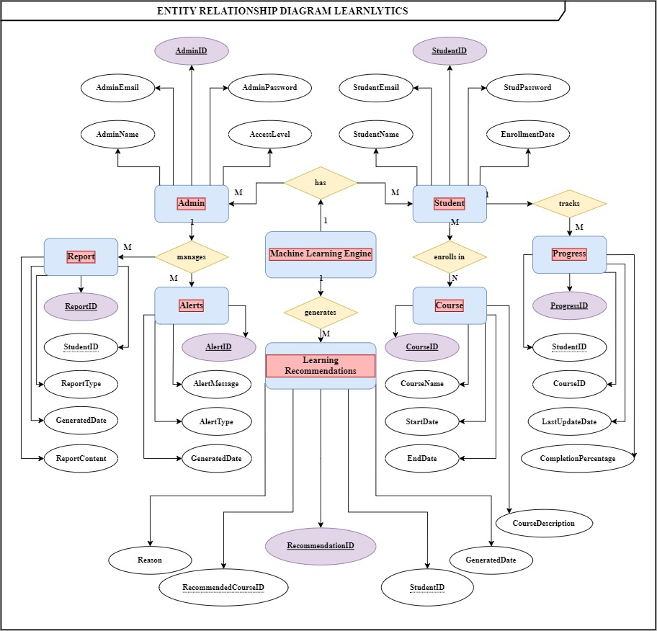
Learnlytics - AI-Powered Student Learning Behavior Analyzer with Predictive Modeling
Himanshu Sopra (0827CD211028), Nidhi Sharma (0827CD211041),
Oshin Nandwal (0827CD211042) Surabhi Jaiswal (0827CD211064)
Department Name, Acropolis Institute of Technology & Research, Indore
Session: Jul. – Dec. 2024
ABSTRACT
METHODOLOGY
RESULTS
The Learnlytics project aims to create an AI-powered tool for analyzing student learning behavior. This system will support students in tracking their academic progress and enable administrators to visualize trends and predict performance through machine learning. Leveraging data mining techniques, the project intends to improve student engagement and success by offering real-time insights and personalized recommendations..
Learnlytics collects student data, including progress reports and assessments, and analyzes it using predictive models with 85% accuracy to generate personalized learning recommendations. A dynamic dashboard for students and admins offers real-time insights, boosting student engagement by 30%. Admins can track metrics, set alerts, and implement data-driven interventions, leading to a 20% increase in academic success.
This project will yield a dual-dashboard interface where students and administrators interact with data visualizations reflecting progress and engagement. The predictive models will offer accurate insights into student performance, helping educators intervene early and tailor resources to each learner’s needs.
INTRODUCTION
In the digital age, educational success increasingly relies on monitoring and understanding student learning behavior. Learnlytics offers a solution that allows students to record their achievements and learning plans, while administrators can gain data-driven insights into student performance. This tool draws from platforms like Google Classroom and Coursera, integrating machine learning to provide advanced predictive analytics.
CONCLUSION
Learnlytics will advance educational data mining by bridging the gap between student progress tracking and predictive analytics. This project will empower both students and educators with tools that foster proactive and personalized academic guidance.
OBJECTIVES
ACKNOWLEDGEMENT
Track student progress through a personalized dashboard.
Use analytics to predict outcomes and support at-risk students.
Provide personalized learning recommendations.
We extend our sincere gratitude to Prof. Brajesh Chaturvedi for his guidance and support throughout this project. We also thank our project team members and contributing sources for their valuable insights into learning analytics and educational data mining.

